Slide 1


Slide 2
Insight Guard CS547 – Information Retrival
Project focused on predicting suicide risk through text analysis

Slide 3






Our Team
Pavan Antala
Rahul Chhatbar
Anurag Gulavane
Anurag Chinthalapati
Neha Bathuri

Slide 4
Table of contents
01
02
03
04
05
06
Abstract and Introduction
Existing Tools
Dataset Overview
Methodology
Results
Conclusion & Future Scope

Slide 5
01
Abstract

Slide 6



Abstract
Mission: Leverage AI to detect suicidal ideation through text analysis.
Goal: Identify linguistic patterns in real-time for timely interventions.
Impact: Empower professionals to bridge the gap between suffering and support.

Slide 7
1.1
Introduction

Slide 8
Introduction (Background & Motivation)
700,000+
Global Health Challenge: deaths annually due to suicide
STIGMA, LIMITED ACCESS, DELAYS
Limitations of Traditional Methods
SCALABLE, AUTOMATED TEXT ANALYSIS,REAL-TIME DETECTION FROM SOCIAL MEDIA
InsightGuard Solution
ADVANCED NLP AND MACHINE LEARNING
Technology
USER-FRIENDLY INTERFACE
Accessibility

Slide 9
02
Existing Tools

Slide 10



Existing Tools
Social Media Monitoring
Hootsuite, Brandwatch
Mental health Chatbot
Webot Health
Text Sentiment Analysis
IBM Watson, Google Cloud

Slide 11

Disadvantages of Existing tools
Lack of Specificity
Most tools categorize emotions without understanding suicidal cues. Example: The phrase “I feel so done with life” might register as sadness instead of a critical risk.
User Dependency: Tools rely on users initiating help or interaction. Many in crisis suffer silently and do not actively seek help.
Delayed Responses: Tools often work retrospectively or with delays, losing the opportunity for timely intervention
High False Positives and Negatives: General sentiment analysis can misinterpret benign posts or miss subtle cries for help.

Slide 12
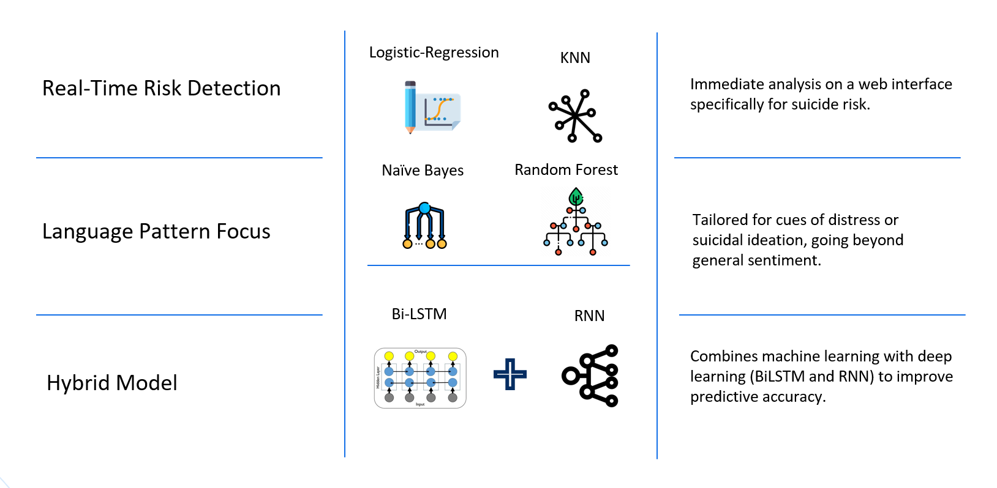
Our Model

Slide 13
Advantages of the selected Models
Machine Learning Models
Logistic Regression: Establishes a simple and interpretable baseline.
KNN: Provides insights by comparing text to similar high-risk cases
Random Forest: Handles complex relationships for better accuracy.
Naïve Bayes: Efficient and quick, ideal for text classification
Deep Learning Model
BiLSTM: Captures context and sequence in the text, crucial for understanding suicidal cues.
Example: Recognizes the shift in tone and recurring patterns indicating distress.

Slide 14
03
Dataset Overview

Slide 15


Dataset About
Source
Pushshift API
Reddit
Reddit posts (2008–2021)
SuicideWatch: Posts expressing suicidal thoughts or seeking help (suicidal).
r/teenagers: Non-suicidal posts for balanced comparison.
Purpose
Enable machine learning models to detect language patterns linked to suicidal ideation.
Support mental health initiatives and suicide prevention efforts.

Slide 16
Dataset Characteristics
Suicide ideation
232,074
Subreddit Breakdown
Depression without explicit suicidal ideation
Total Posts
Non-suicidal

Slide 17
04
Methodology

Slide 18
Feature Extraction
Text Cleaning
Tokenization
TF-IDF
Stopword Removal
Lemmatization
Word Embeddings
Data Preprocessing
Feature Extraction

Slide 19


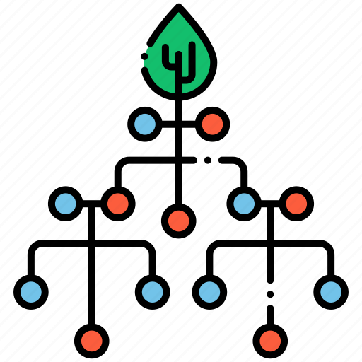

Model Development
Machine Learning
Logistic-Regression
K-Nearest Neighbors
Multinomial Naive Bayes
Random Forest
Notes:
K-Nearest Neighbors (KNN): A simple yet effective classification algorithm based on the proximity of data points.
Logistic Regression: A statistical model used for binary classification tasks, particularly when the relationship between input features and target labels is linear.
Multinomial Naive Bayes (NB): A probabilistic model ideal for text classification tasks with discrete features.
Random Forest: An ensemble learning method that constructs multiple decision trees and aggregates their predictions to improve accuracy.

Slide 20

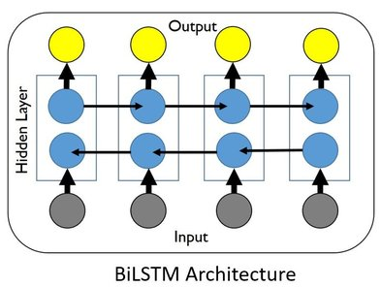
Model Development
Deep Learning
Bi-LSTM
RNN
Notes:
BiLSTM (Bidirectional Long Short-Term Memory): A type of Recurrent Neural Network (RNN) that can capture long-range dependencies in the text while processing it in both forward and backward directions.
RNN (Recurrent Neural Network): A model designed for sequence data that remembers information from previous inputs, making it suitable for text analysis.

Slide 21
05
Results

Slide 22
Evaluation Table
 | Precision | Recall | F1 Score | Accuracy
Deep Learning | 0.903 | 0.964 | 0.933 | 0.930
Logistic Regression | 0.9452 | 0.9188 | 0.9318 | 0.9325
KNN | 0.9165 | 0.8272 | 0.8696 | 0.8754
Multinomial NB | 0.8724 | 0.9502 | 0.9096 | 0.9052
Random Forest | 0.8965 | 0.9123 | 0.9043 | 0.9030

Slide 23
Graphs (Deep Learning)
Loss
Notes:
BiLSTM (Bidirectional Long Short-Term Memory): A type of Recurrent Neural Network (RNN) that can capture long-range dependencies in the text while processing it in both forward and backward directions.
RNN (Recurrent Neural Network): A model designed for sequence data that remembers information from previous inputs, making it suitable for text analysis.

Slide 24
Graphs (Deep Learning)
Accuracy
Notes:
BiLSTM (Bidirectional Long Short-Term Memory): A type of Recurrent Neural Network (RNN) that can capture long-range dependencies in the text while processing it in both forward and backward directions.
RNN (Recurrent Neural Network): A model designed for sequence data that remembers information from previous inputs, making it suitable for text analysis.

Slide 25
06
Conclusion & Future Scope

Slide 26
Conclusion
Purpose
Findings
Impact
Utilized machine learning to identify key factors contributing to suicides and predict at-risk individuals
Highlighted socio-economic, psychological, and demographic influences on suicide rates.
Demonstrated the effectiveness of data-driven approaches in mental health analysis.
Offers actionable insights for policymakers and healthcare professionals to address mental health challenges.

Slide 27
Future Scope
Advanced Modeling
Analysis
Human Annotation
Improve feature engineering with latent factor analysis.
Develop models for real-time suicide risk prediction.
In-context Learning
Adding sentiment analysis for deeper emotional insights.
Collaborating with mental health organizations will extend the tool’s reach, making it an invaluable asset in addressing and supporting global mental health needs.

Slide 28
Thank You
Save Lives!
Save People!

Slide 29
Resources
https://www.kaggle.com/datasets/nikhileswarkomati/suicide-watch?resource=download
freepik.com/
https://fontawesome.com/icons
https://slidesgo.com/theme/psychopathology-case-report
https://pmc.ncbi.nlm.nih.gov/articles/PMC9565132/

